Slide 1
IoT Assignment 3
Isak Skeie

Slide 3
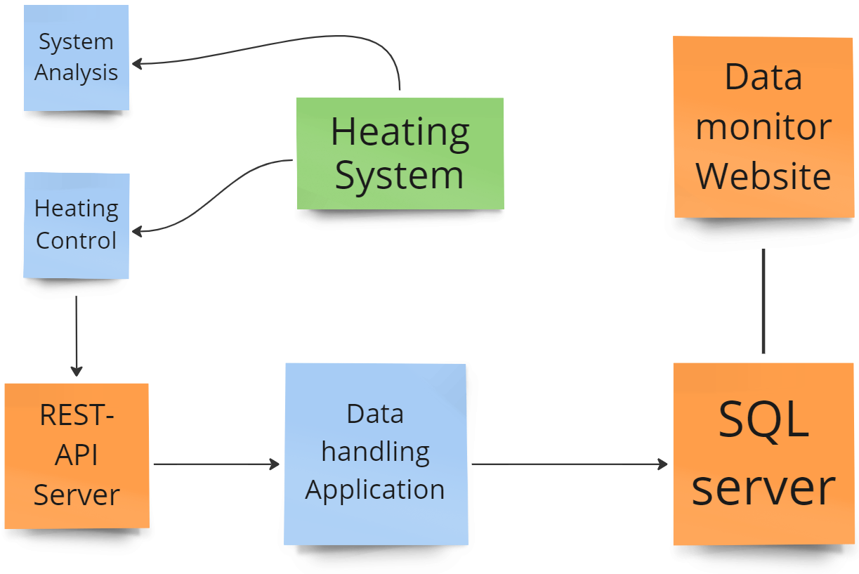
Project Overview

Slide 4
Development tools
Development tools
Visual Studio Code
Visual Studio
Azure cloud service
SQL Server management tool
Platforms and frameworks
Python 3.11
.Net 7.0
Flask, with REST API
Pyinstaller
Azure
SQL

Slide 5
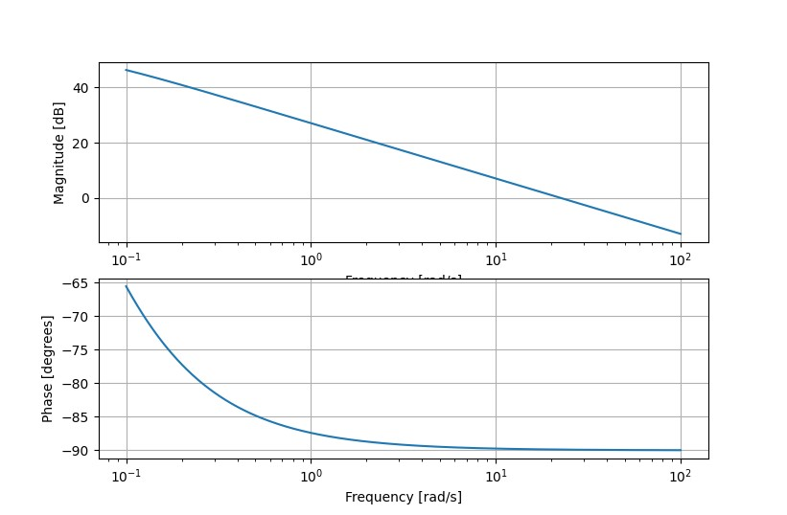
Frequence analysis
Real pole at -0.04545455
Filter Parameterization
Notes:
No delay for system

Slide 6
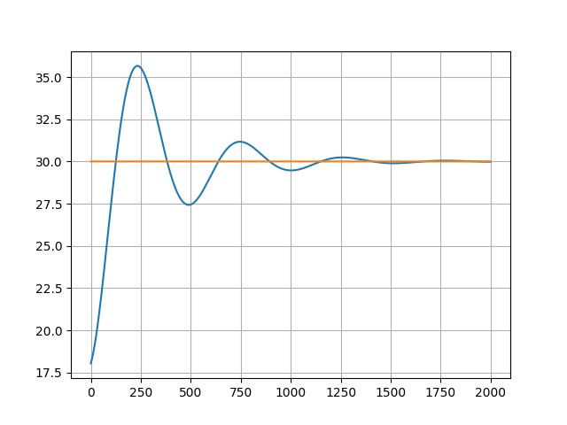
Heating System Simulation and Control
What is acceptable overshoot?
How big van U be? It reaches 8V
Kp = 0.1
Ki = 0.01
Simulation of 200s

Slide 7
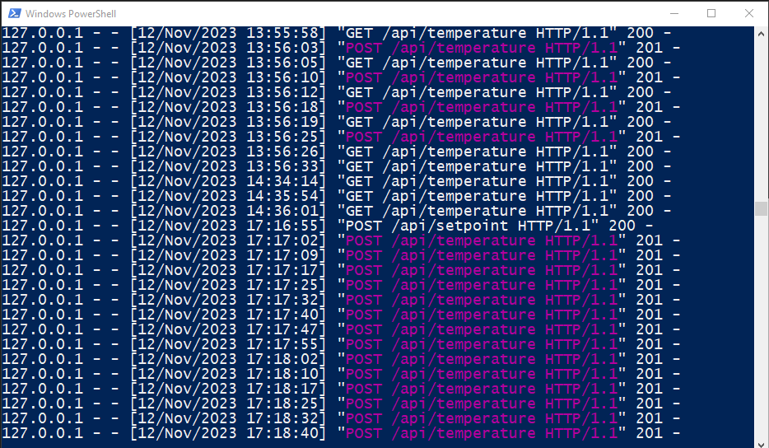
Flask server
Python flask server
Retrieves Temperature and Setpoint
Can send the most recent data entry
From python to .exe

Slide 8
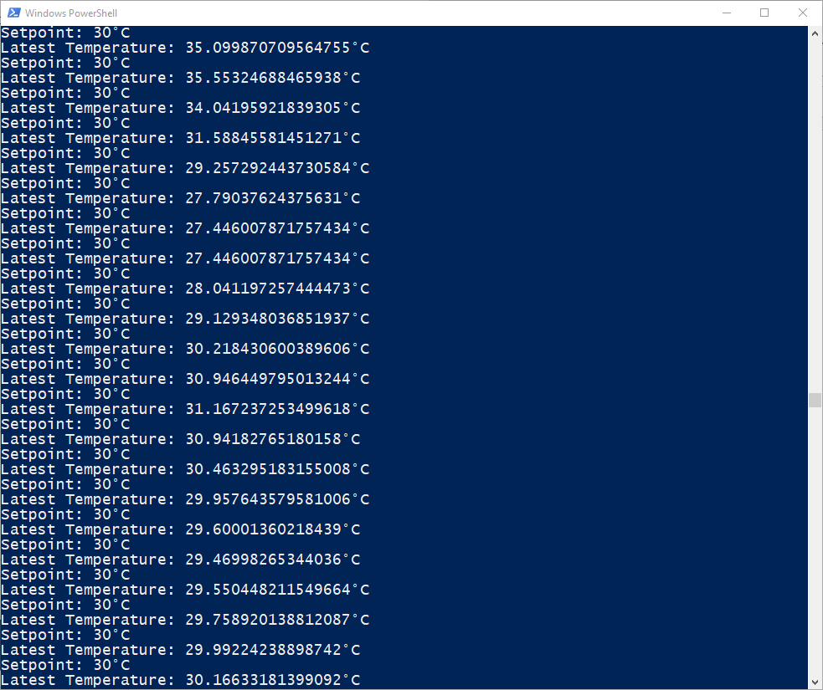
Database Application
Developed in python
Built into .exe file
GET request from flask server
Sends to SQL through Storage procedure

Slide 9
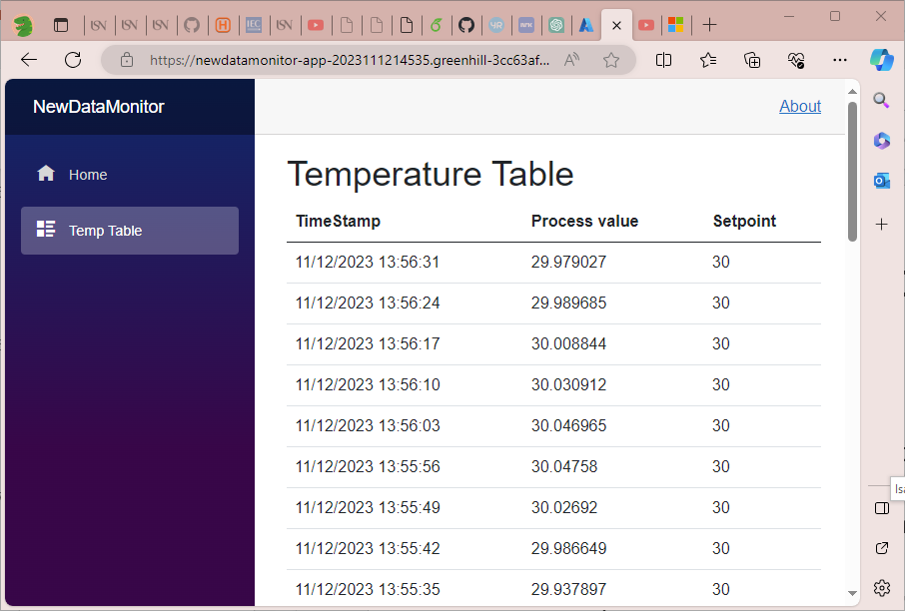
Data monitoring Website
Developed on Blazer framework with .Net 7.0
SQL connection through Entity framework
Shows temperature stats and 40 latest entry in a table

Slide 10
Cyber Security
SQL injections
User access
Storage Procedures
Azure deployment
GDPR?
Flask server vulnerabilities?

